Slide 1
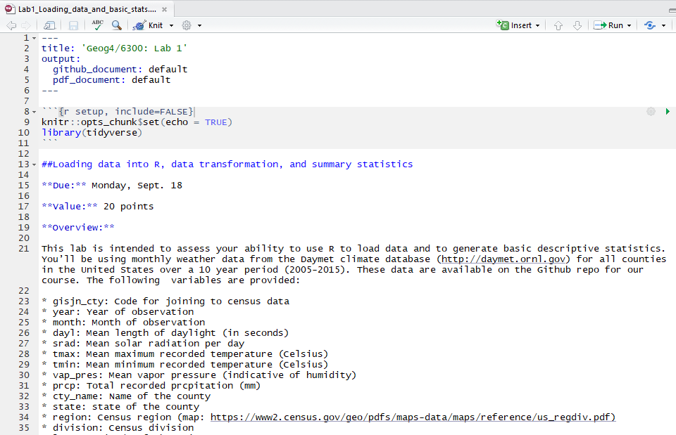
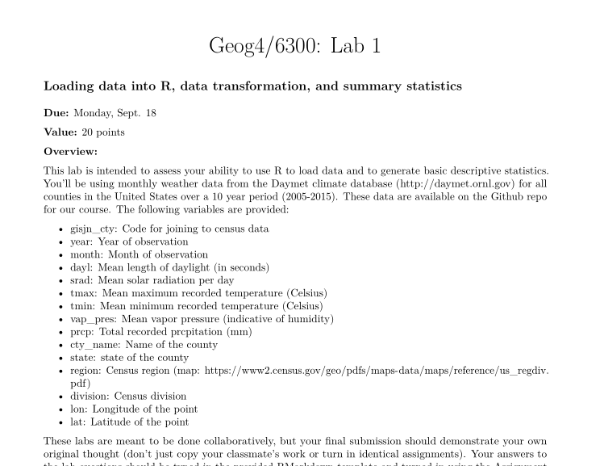
Using R Markdown Geog4/6300-Shannon

Slide 2
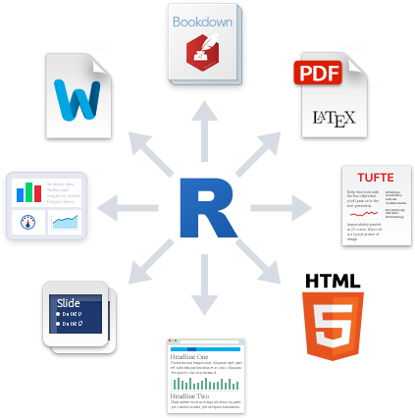


Markdown: A code based formatting tool for text documents.

Slide 3
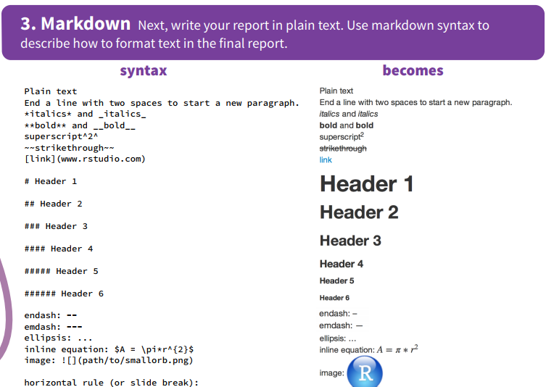

Slide 4
Why are we using Rmarkdown?
Provides an easy way to share code and your results.
Results always match the code
Readable formatting for code
No cutting and pasting needed

Slide 5
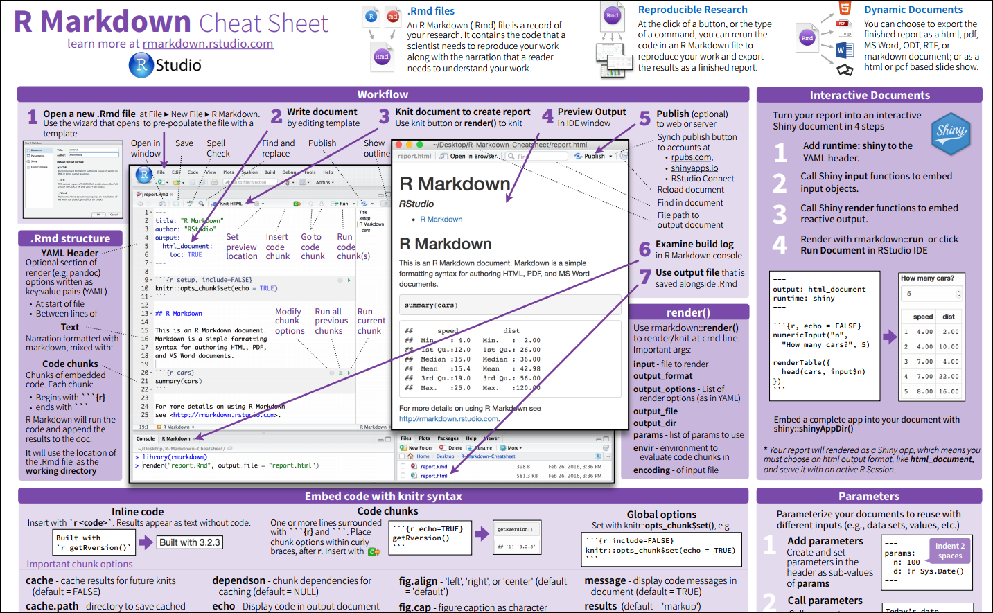
https://www.rstudio.com/wp-content/uploads/2016/03/rmarkdown-cheatsheet-2.0.pdf

Slide 6
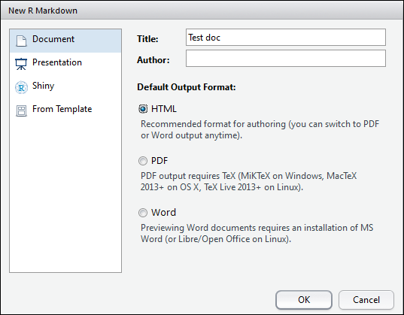

Slide 7
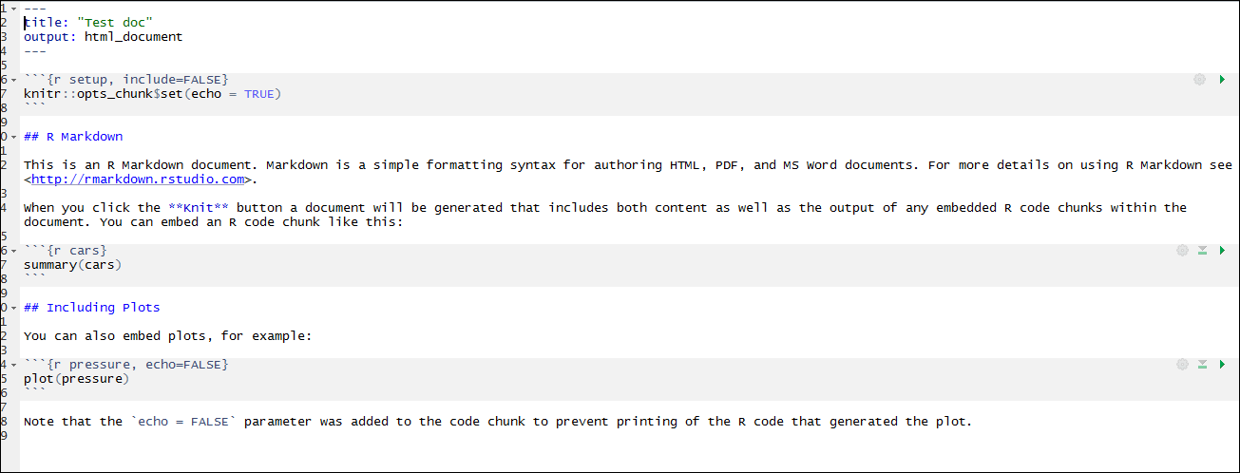

Slide 8
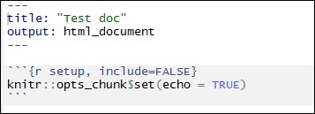
Title can be anything
Output: Can also do pdf_document, word_document, etc.
R code contained in the ```{r} brackets. Can include loading libraries, etc.

Slide 9
Title can be anything
Output: Can also do pdf_document, word_document, etc.
R code contained in the ```{r} brackets. Can include loading libraries/packages/data.

Slide 10
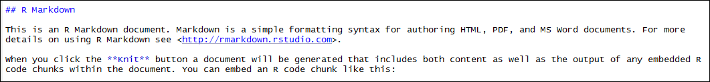
This will be rendered as plain text with formatting.
## = header
** = bold
Etc…

Slide 11
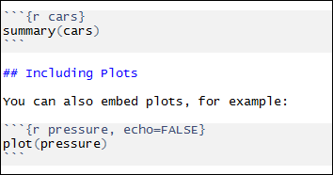

Embedded R code can render data or plots
Use the “Knit” button to render the code.

Slide 12
You try it!
Make your own Rmarkdown document
Copy code from last week to load the Daymet data you downloaded.
Create a histogram of the tmax variable (use the hist function.
Create data frame with yearly mean precipitation.
Use “plot” to plot mean precip against year. Look up “?plot” to see how it works.

